Slide 1
TAP into Museums Creating open source tools for the mobile web
Kris Arnold
Software Applications Developer
Indianapolis Museum of Art
karnold@IMAmuseum.org

Slide 2
2 year National Leadership Grant from the IMLS
A collaboration of Museums, Vendors, and Content Experts
Create open-source tools that can be used in full or in pieces to support the creation of mobile experiences in museums
Build community support and adoption of the TourML metadata specification as a means of representing the content of mobile museum experiences
Successfully use these tools and methods to launch and document mobile experiences in each of the partner museums
Goals of the TAP & TourML Project

Slide 3
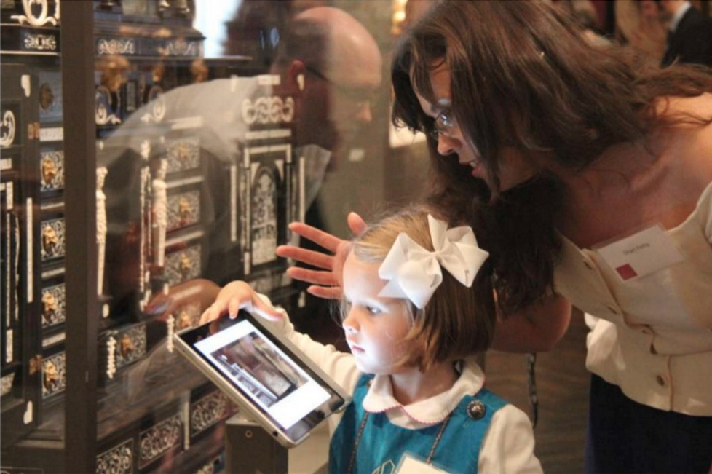
Content Authoring Environment
Native iOS Mobile App
jQuery Mobile Web App
Open Standard for storing and accessing tour data
What is TAP & TourML?

Slide 4
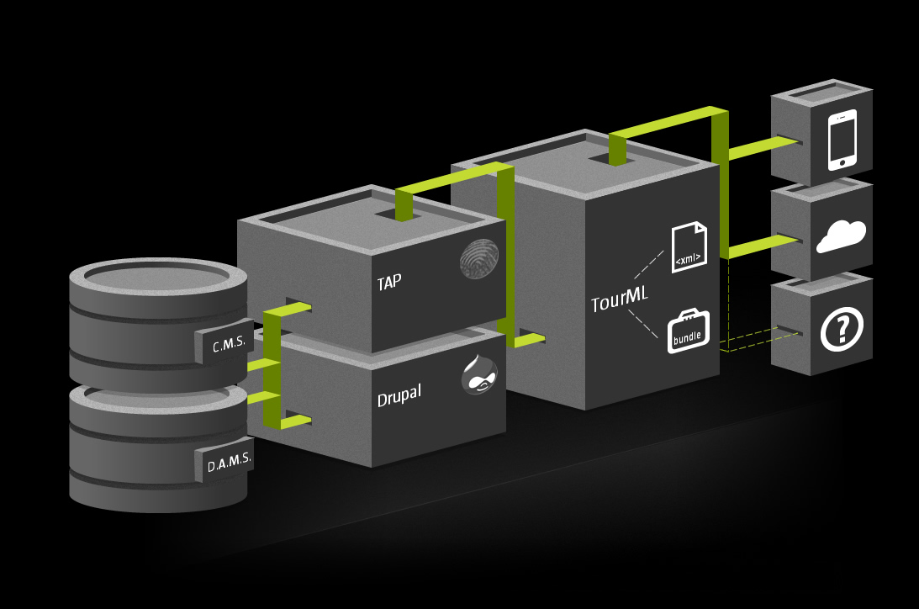
Application Layer
Content Layer
Authoring Layer
Building blocks of TAP

Slide 5
Tour
Stop
Stop
Stop
Stop
Stop
Asset
Asset
Asset
Asset
Connection
Asset Reference
TourML: A specification for mobile tour content… or story structure generally.
Notes:
A Story Structure specification

Slide 6
TourSet
TourML: Content Layer

Slide 7
TourSet
Tour
TourMetadata
Asset
Stop
Connection
TourML: Content Layer

Slide 8
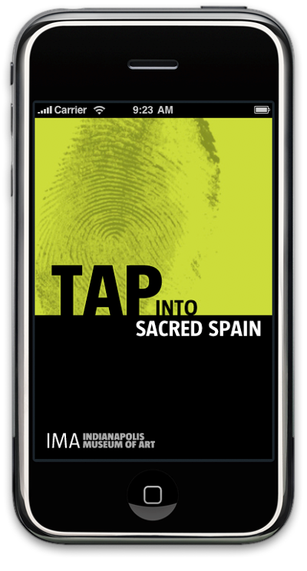
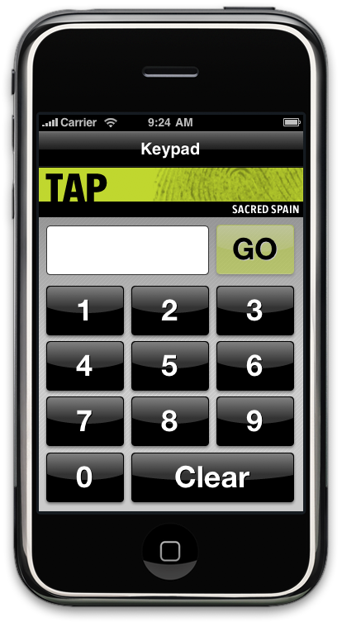
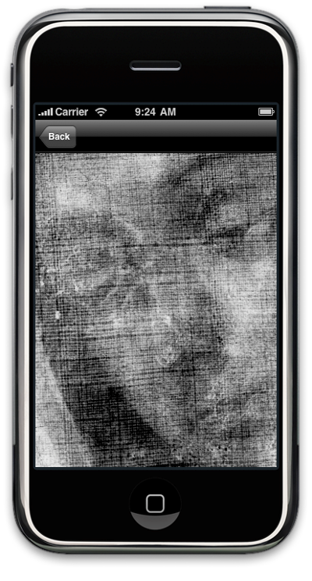
TAP: Application Layer

Slide 9
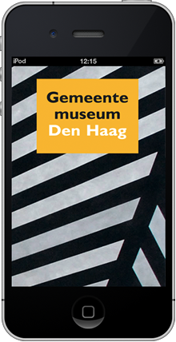
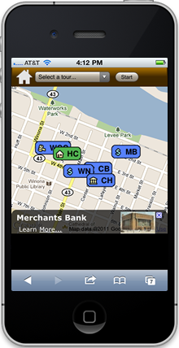
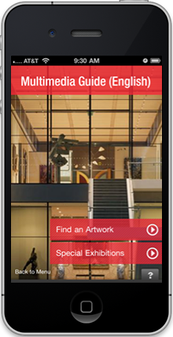
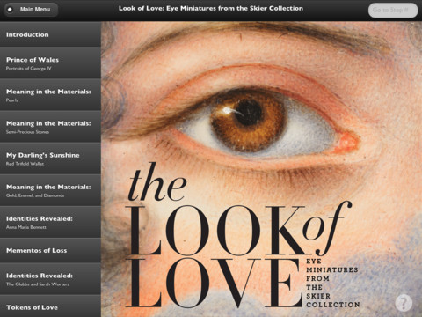
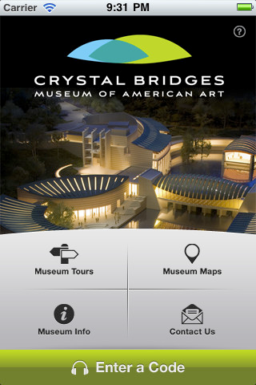
TAP: Application Layer
Notes:
Content experiences are specific and personal per institution.

Slide 10
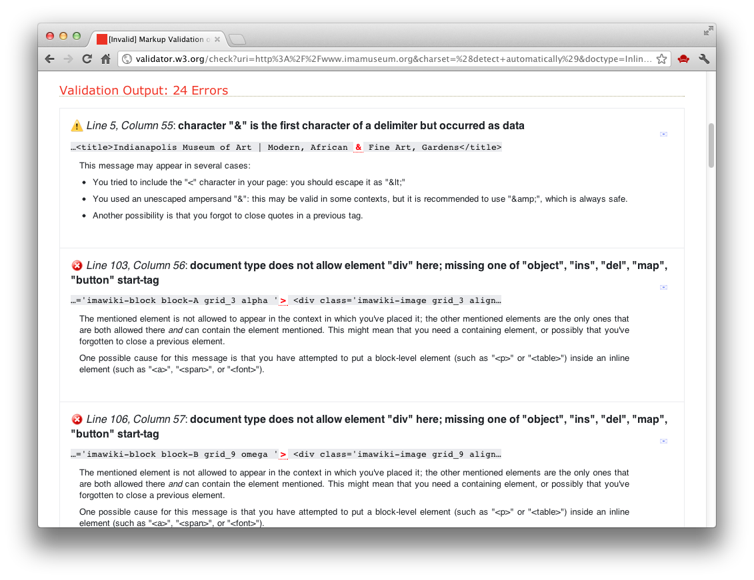
TourML: Validation Tools

Slide 11
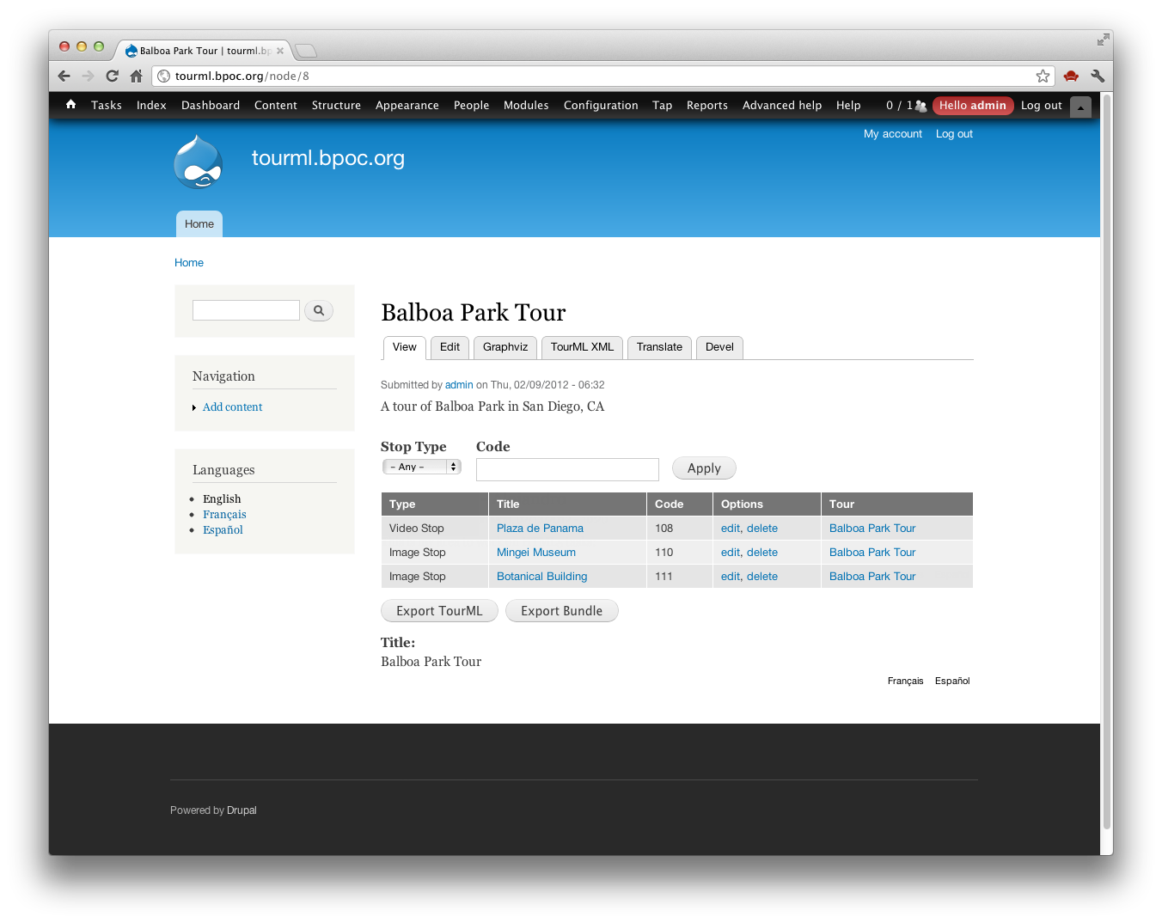
TAP: Authoring Layer

Slide 12
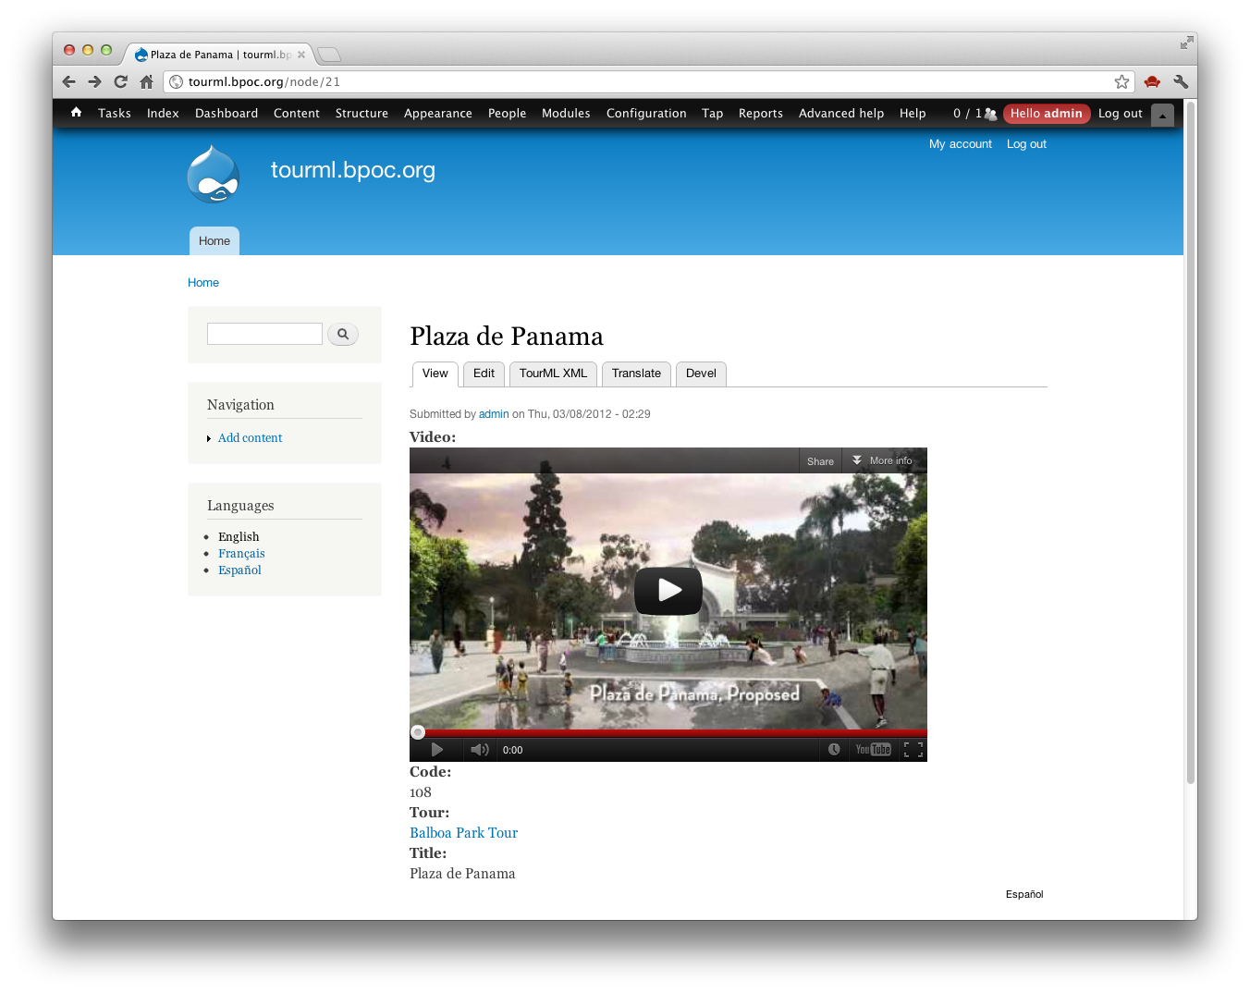
TAP: Authoring Layer

Slide 13
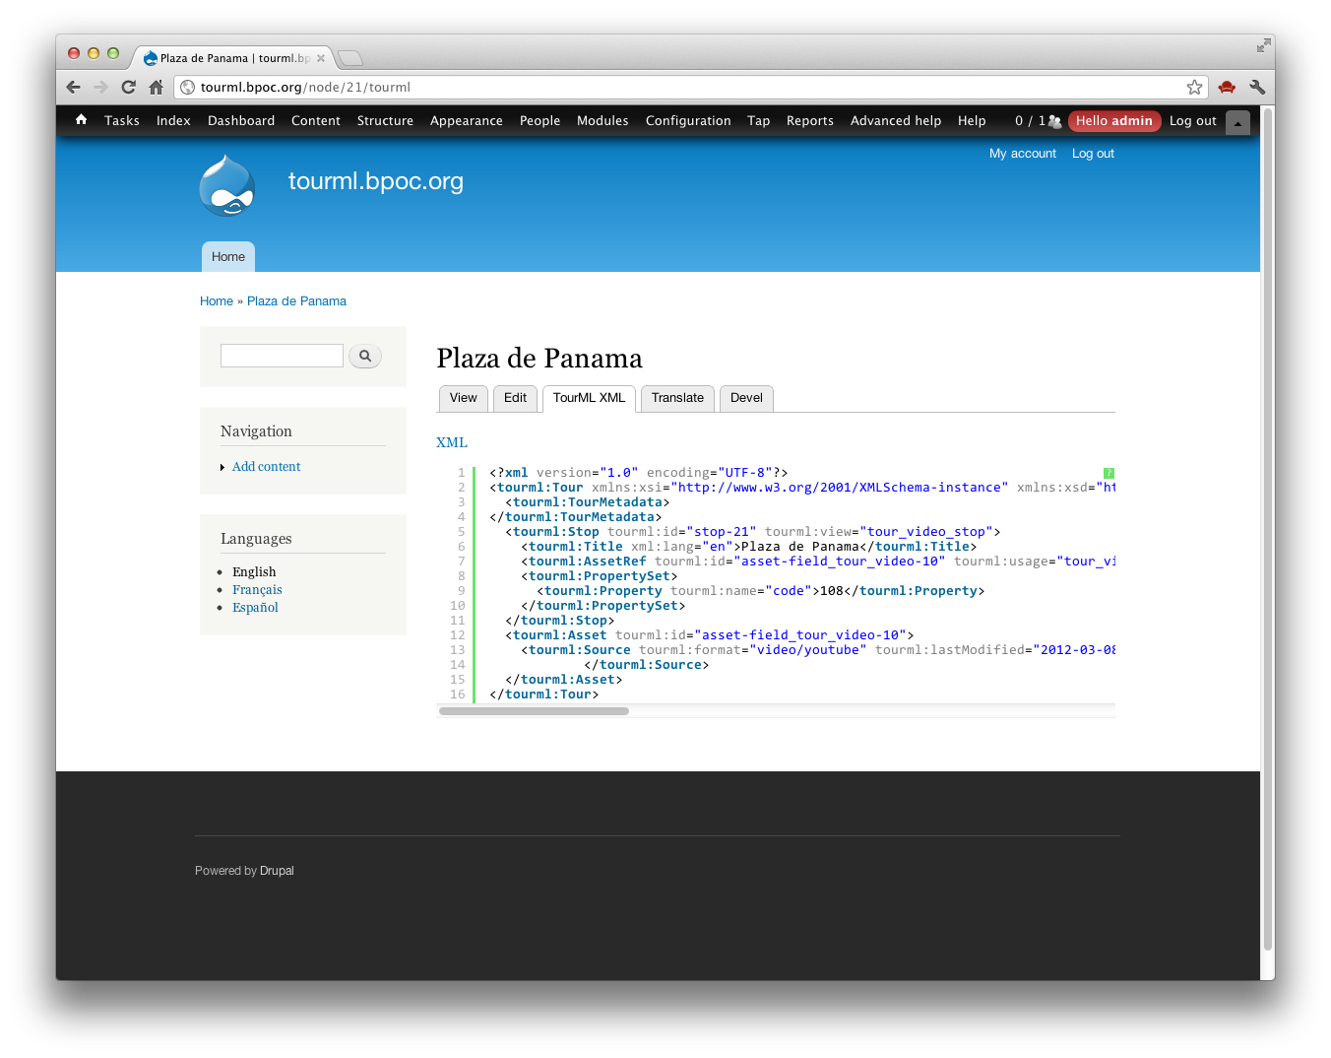
TAP: Authoring Layer

Slide 14
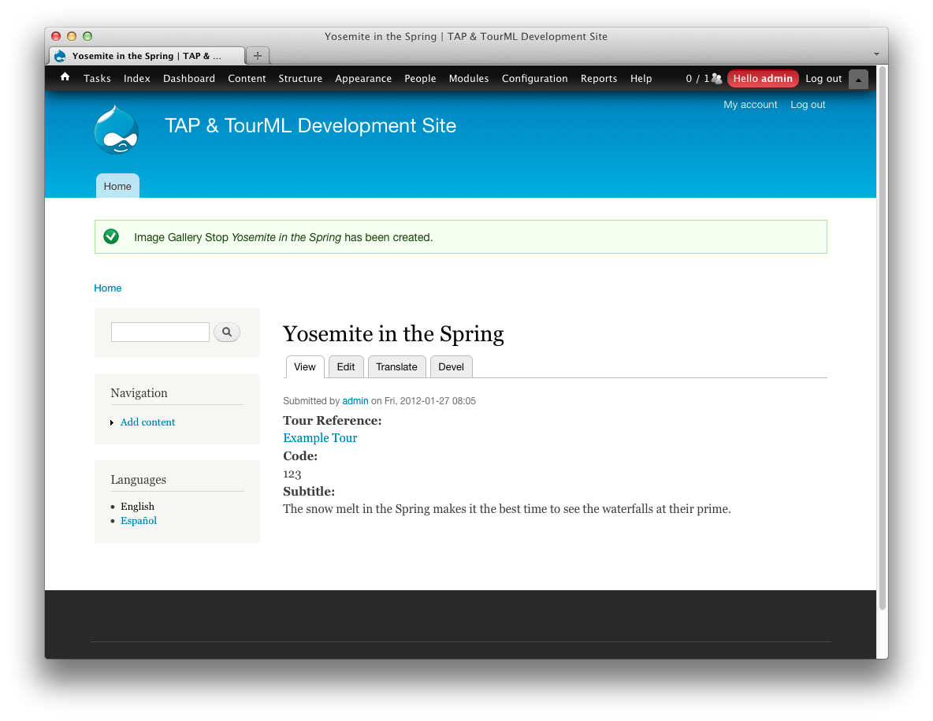
TAP: Authoring Layer

Slide 15
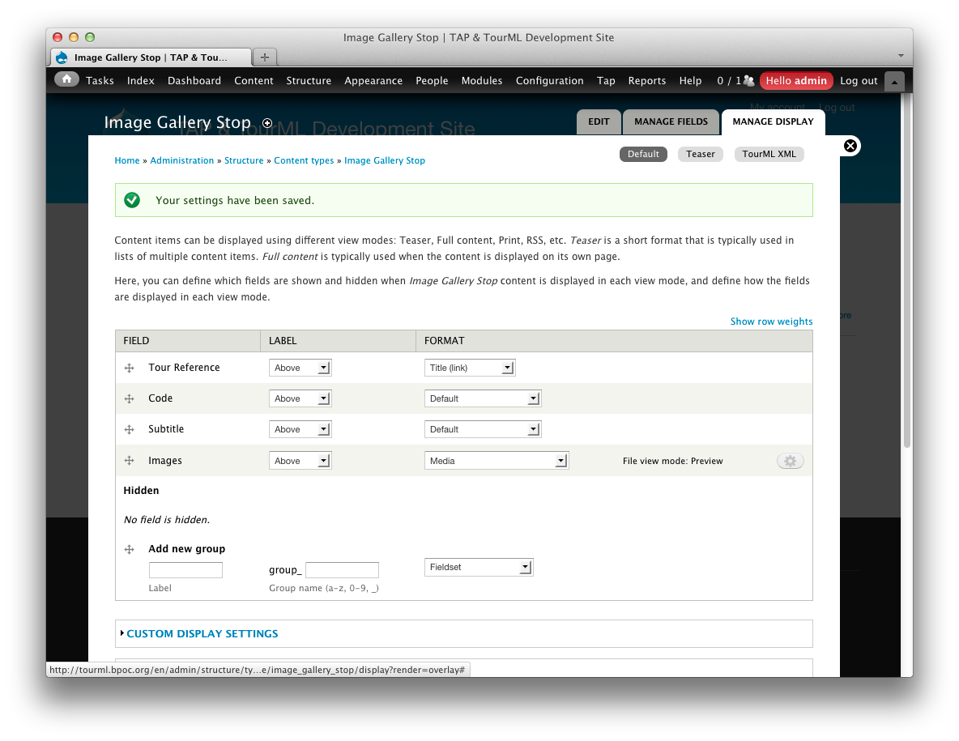
TAP: Authoring Layer

Slide 16
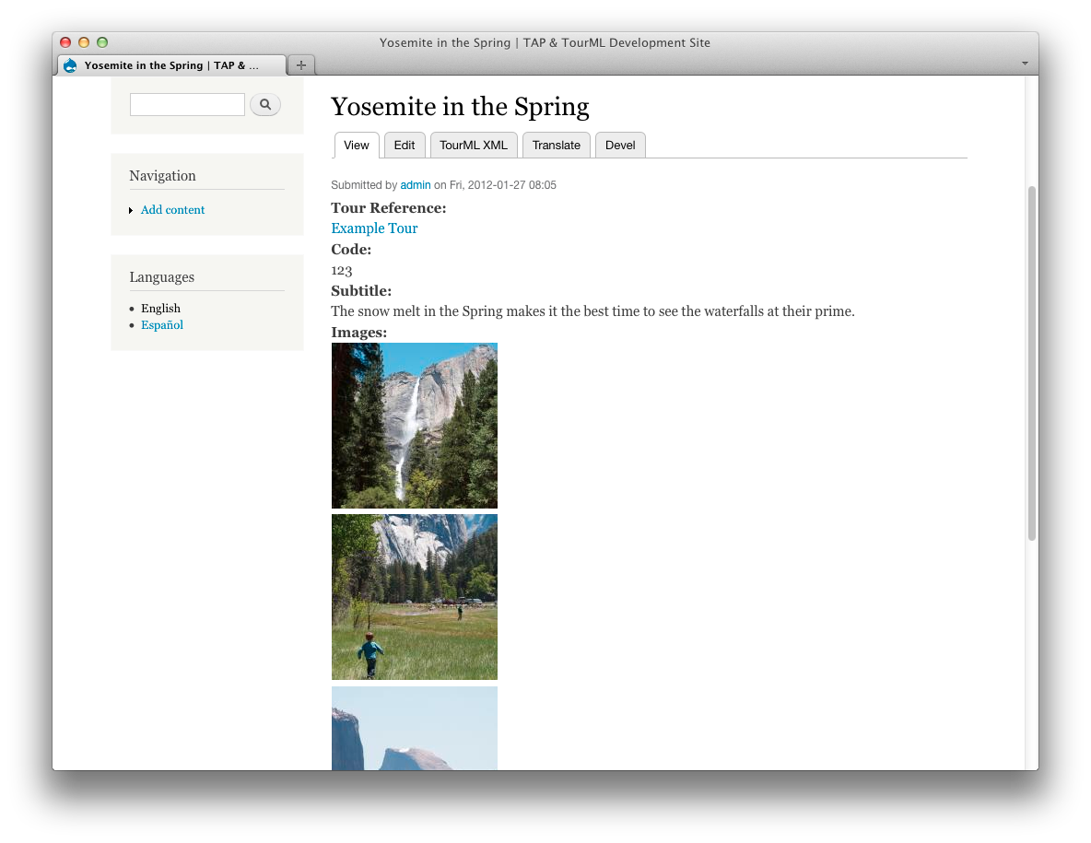
TAP: Authoring Layer

Slide 17
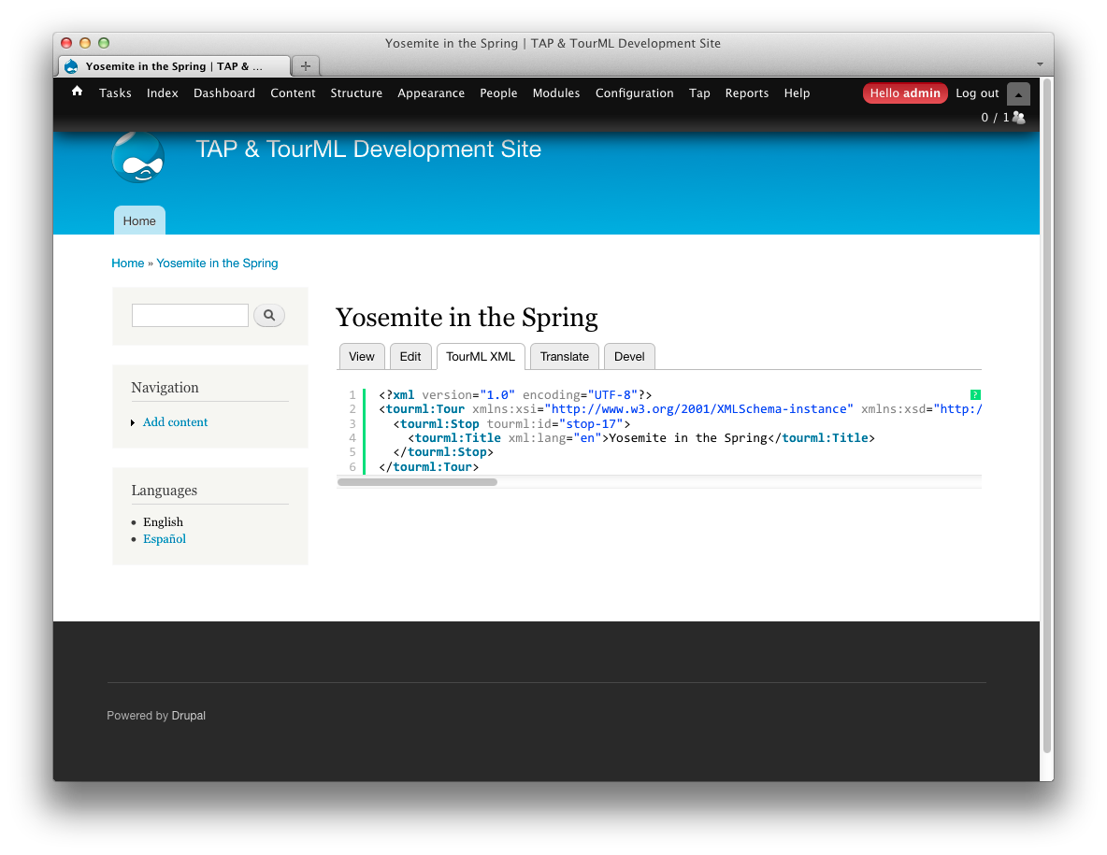
TAP: Authoring Layer

Slide 18
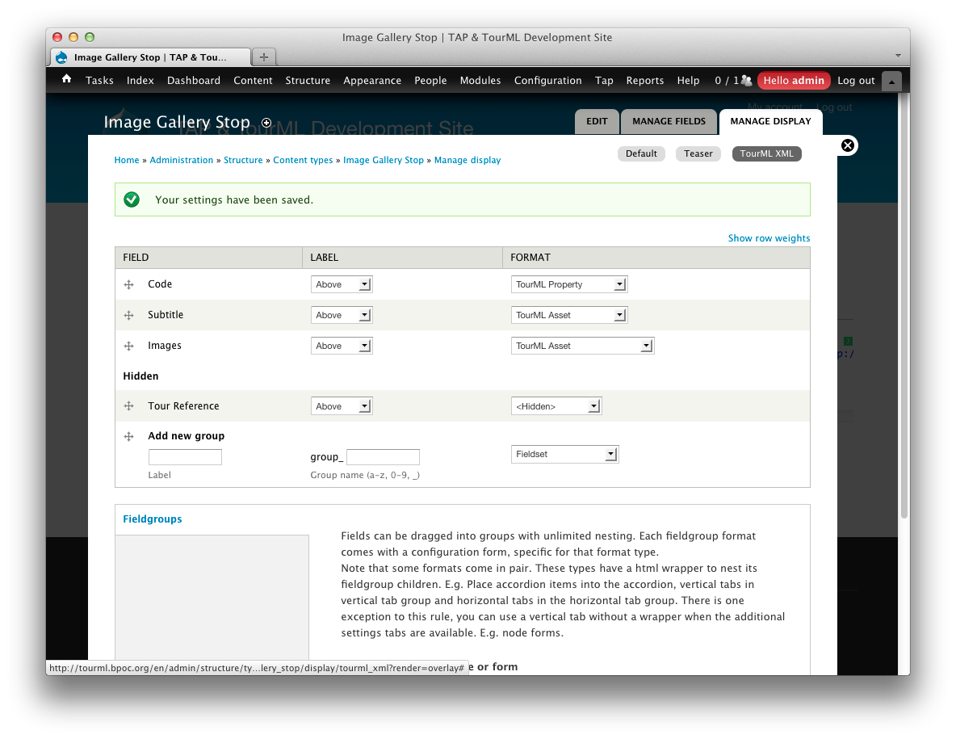
TAP: Authoring Layer

Slide 19
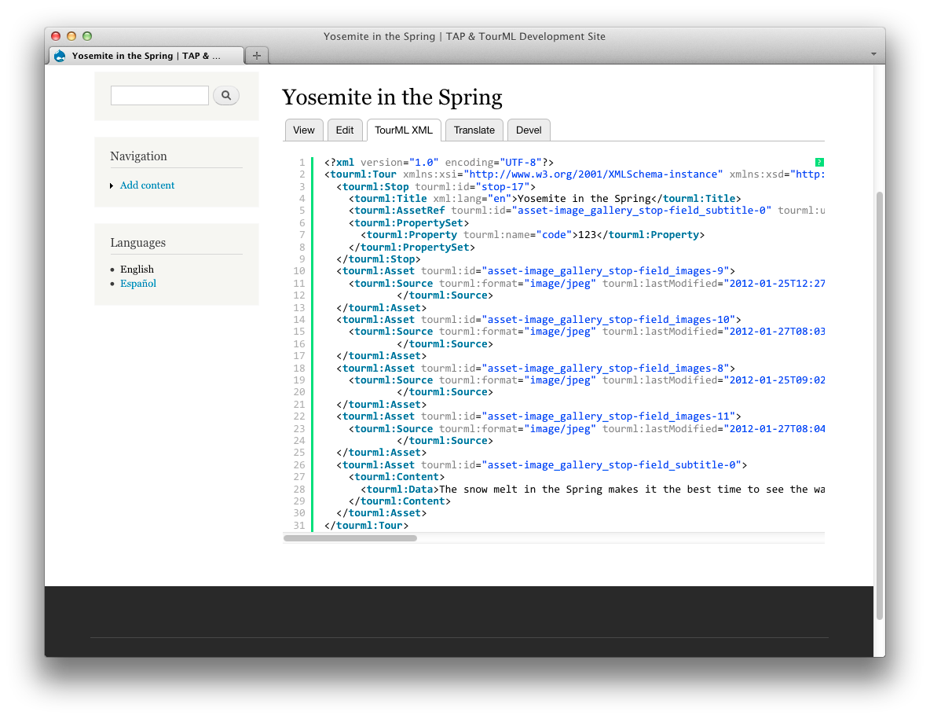
TAP: Authoring Layer

Slide 20
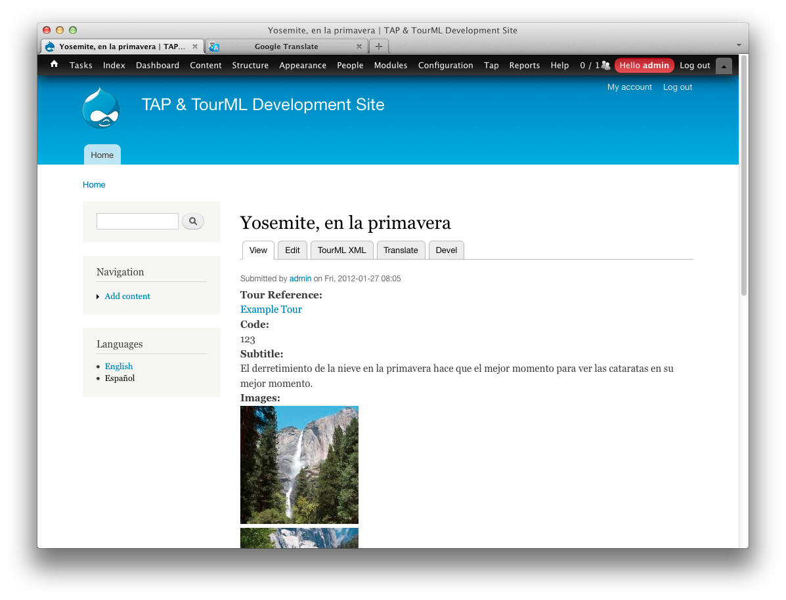
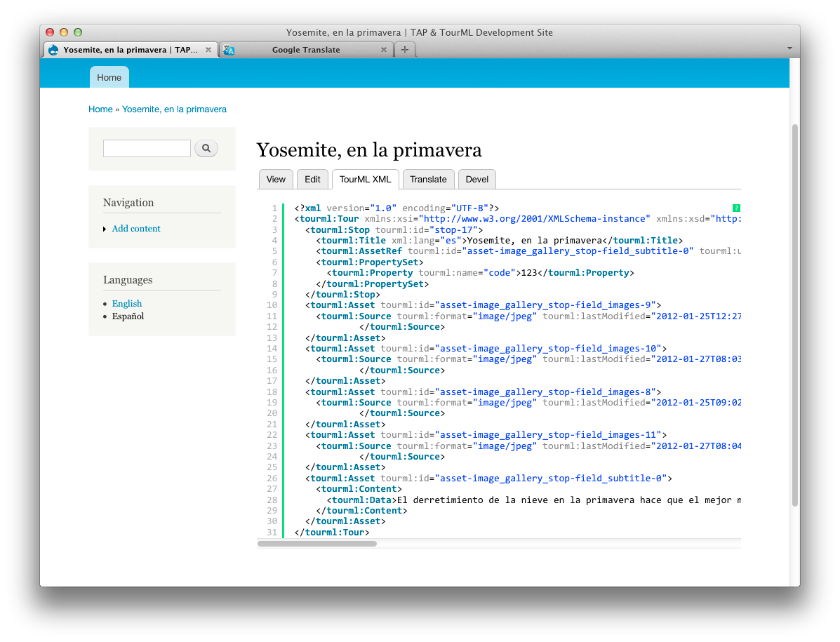
TAP: Authoring Layer

Slide 21
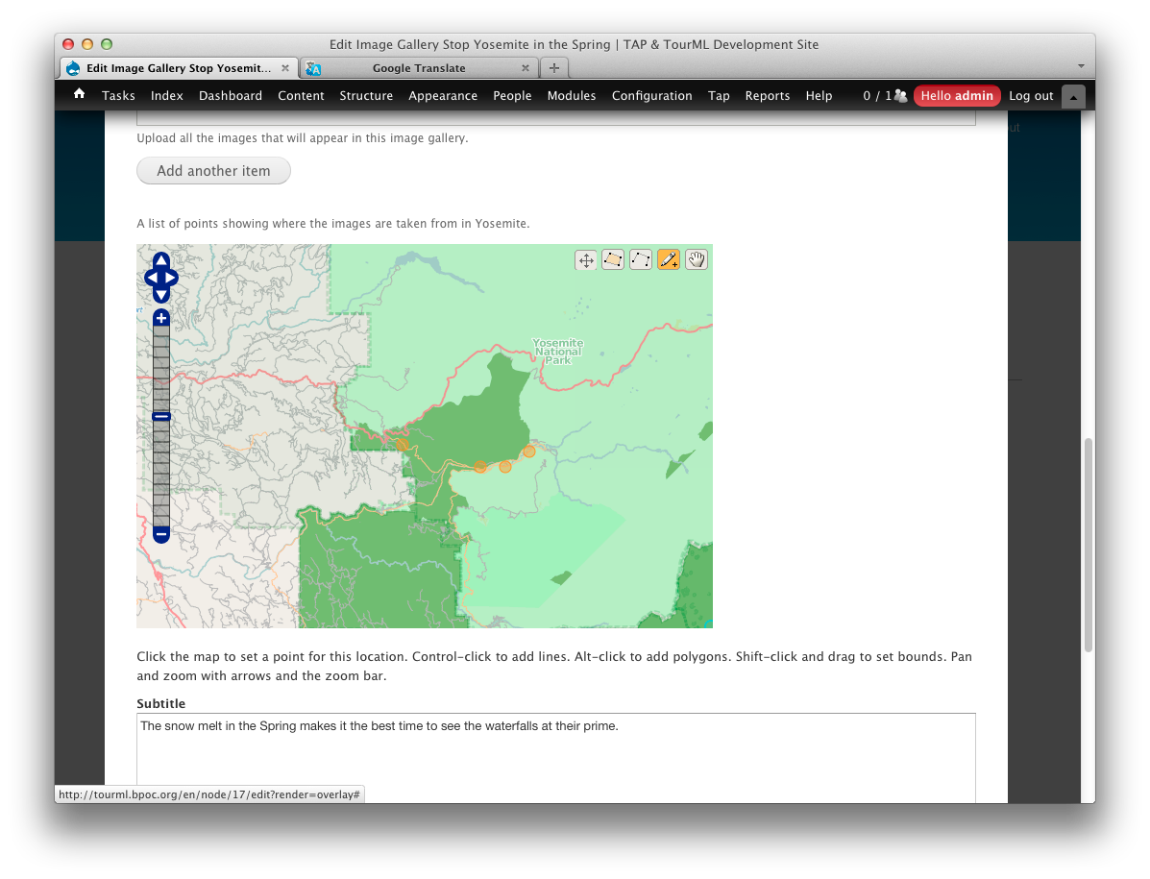
TAP: Authoring Layer

Slide 22
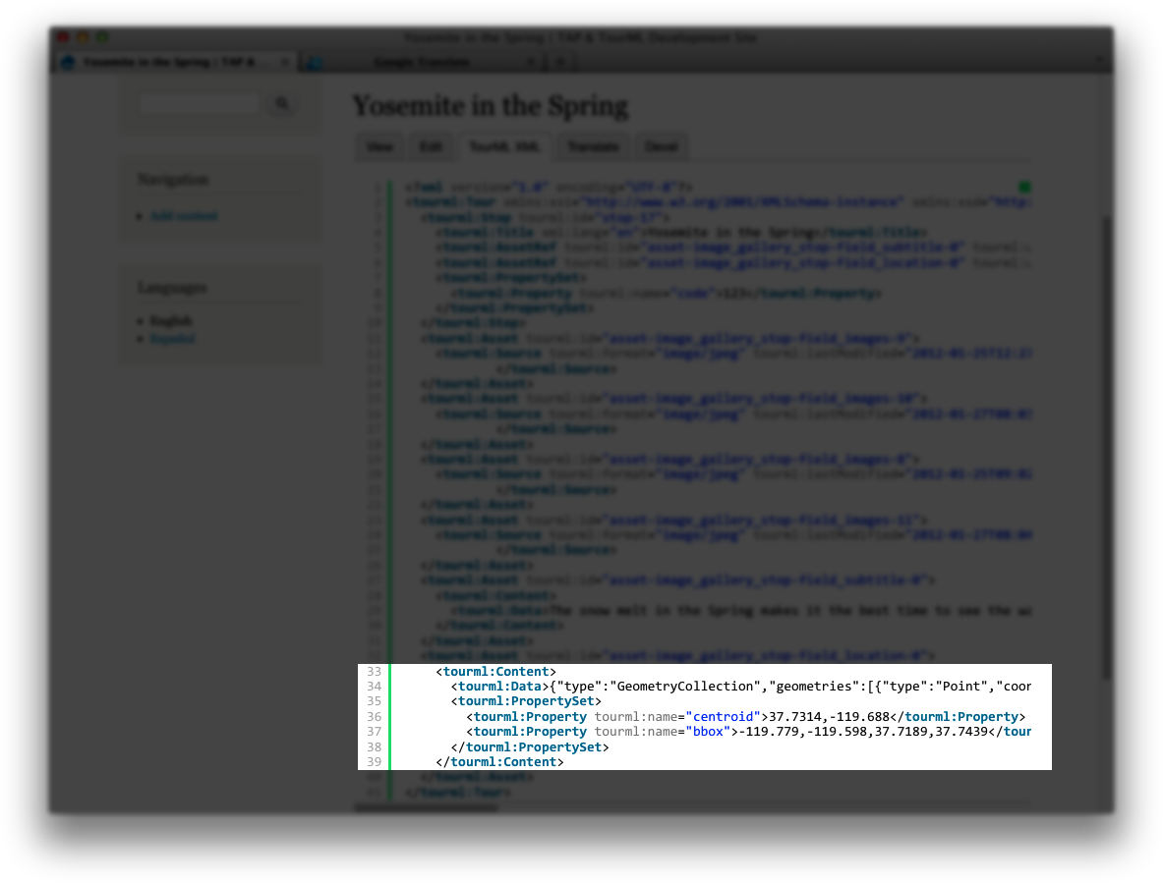
TAP: Authoring Layer

Slide 23
Thanks. – http://www.TAPintoMuseums.org
Kris Arnold
Software Applications Developer
Indianapolis Museum of Art
karnold@IMAmuseum.org

